Slide 1

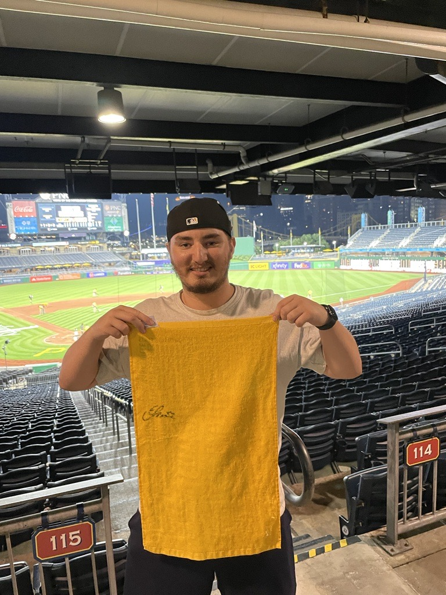

WEBD 6201 Client-Side Durham College
Presentation by: Group 11
Rob Savoie & Rhys Thompson
January 26, 2023
Rhys Thompson
ID:100845373
Rob Savoie
ID:100402087

Slide 2


